Slide 1
Lecture 11
Matrix condition number Proof of main theorem

Slide 2

Predicting the Error Magnification Factor
The objective of this lecture is to give a simplified proof of the central theorem on matrix conditioning number:
Theorem
The largest to be expected error magnification factor when solving a linear system of equations $A\underline{x}=\underline{b}$ is given by:
$$\text{cond}\left(A\right)={\left\|A\right\|}_{∞}∙{\left\|A^{−1}\right\|}_{∞}$$
Notes:
The objective of this lecture is to give a simplified proof of the central theorem on matrix conditioning number
The mathematics in this lecture are a little more involved than in other ones.
If you have hard time to follow some of the aspects, try to get the general idea and skip the details.
Having a general idea is enough for the reminder of the semester.

Slide 3
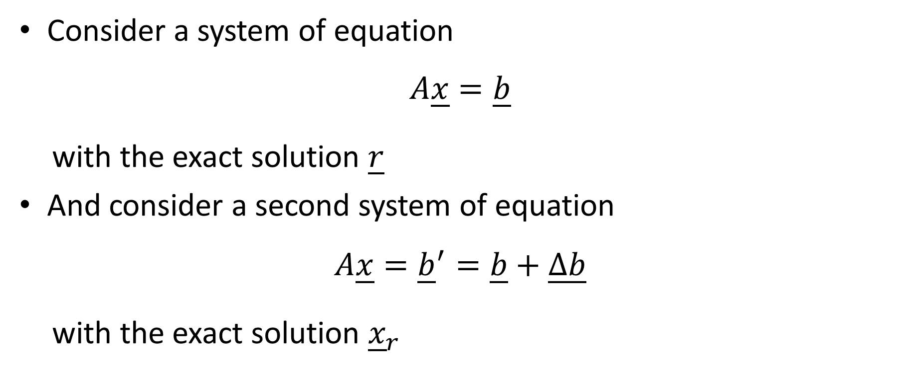
Consider a system of equation
$$A\underline{x}=\underline{b}$$
with the exact solution $\underline{r}$
And consider a second system of equation
$$A\underline{x}={\underline{b}}^{′}=\underline{b}+\underline{∆b}$$
with the exact solution ${\underline{x}}_{r}$
Notes:
We start by considering a system Ax=b with exact solution r.
Further we consider a second system Ax=b’ with b’ obtained by adding some vector Delta b to b
This system has the exact solution xr.

Slide 4
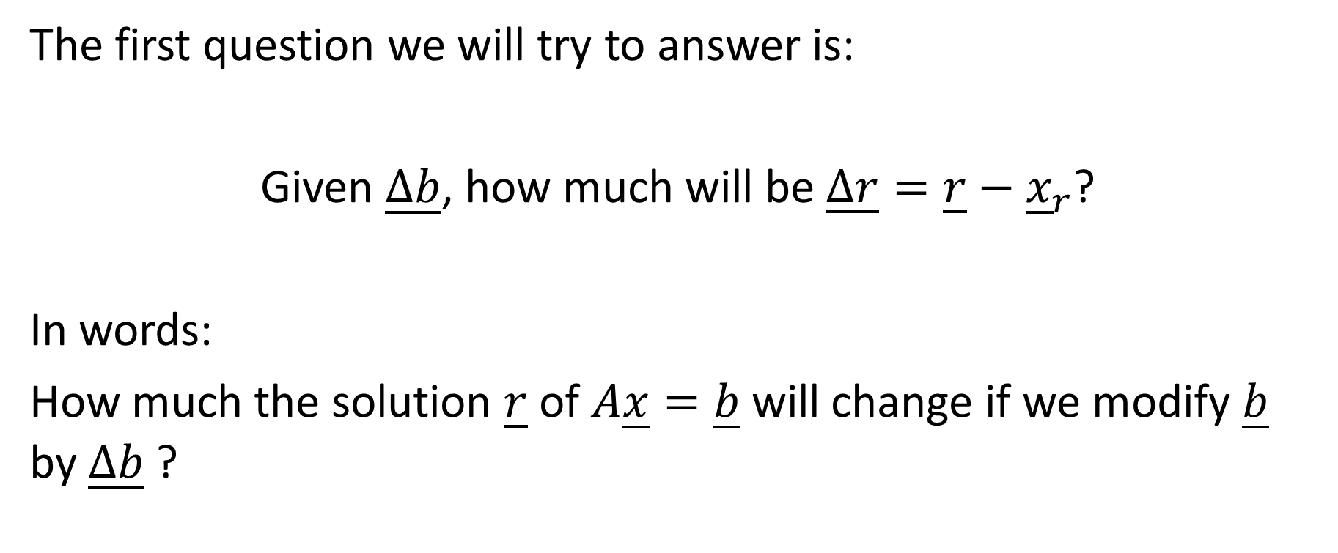
The first question we will try to answer is:
Given $\underline{∆b}$, how much will be $\underline{∆r}=\underline{r}−{\underline{x}}_{r}$?
In words:
How much the solution $\underline{r}$ of $A\underline{x}=\underline{b}$ will change if we modify $\underline{b}$ by $\underline{∆b}$ ?
Notes:
The first step in the proof is to try to find a relation between Delta b and Delta r
Delta b is the amount we modified the initial system Ax=b
Delta r is the difference between the exact solution of Ax=b and the exact solution of Ax=b’
In other words we want to know by how much our solution will change if we modify our right hand side vector by Delta b.

Slide 5

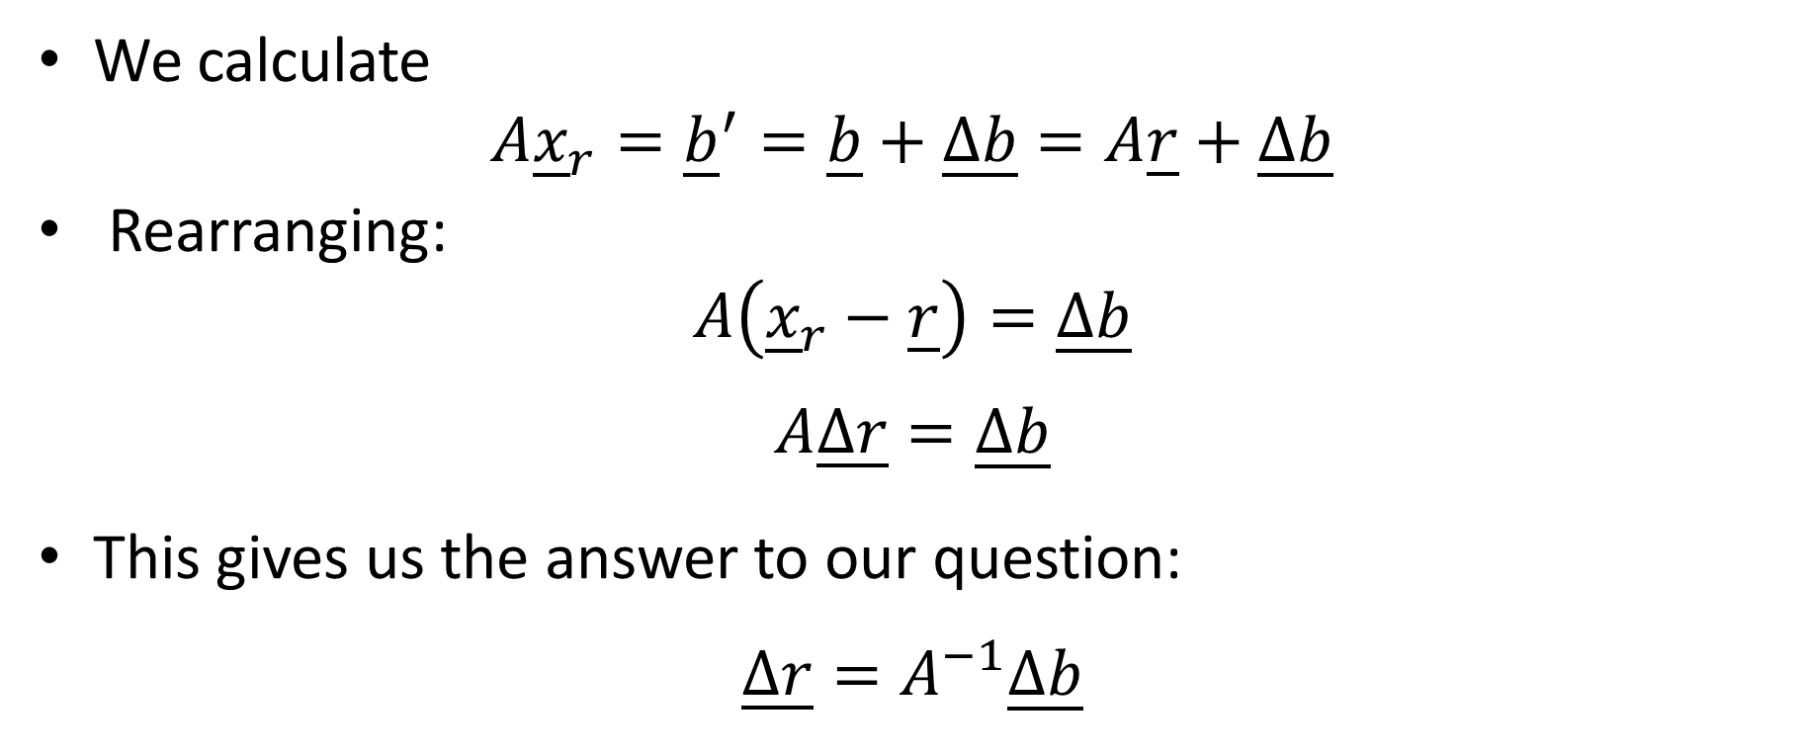
How much is $\underline{∆r}$ given $\underline{∆b}$ ?
We calculate
$$A{\underline{x}}_{r}={\underline{b}}^{′}=\underline{b}+\underline{∆b}=A\underline{r}+\underline{∆b}$$
Rearranging:
$$A\left({\underline{x}}_{r}−\underline{r}\right)=\underline{∆b}$$
$$A\underline{∆r}=\underline{∆b}$$
This gives us the answer to our question:
$$\underline{∆r}=A^{−1}\underline{∆b}$$
Notes:
For this we calculate $A\underline{x_{r}}$
As $\underline{x_{r}}$ is the solution of our modified system, $A\underline{x_{r}}={\underline{b}}^{′}$.
Further ${\underline{b}}^{′}=\underline{b}+\underline{∆b}$.
And as $\underline{r}$ is the solution of Ax=b, we can write that $\underline{b}+\underline{∆b}=A\underline{r}+\underline{∆b}$
Rearranging our relations we get $A\underline{∆r}=\underline{∆b}$
This gives us the answer to our question: $\underline{∆r}=A^{−1}\underline{∆b}$

Slide 6

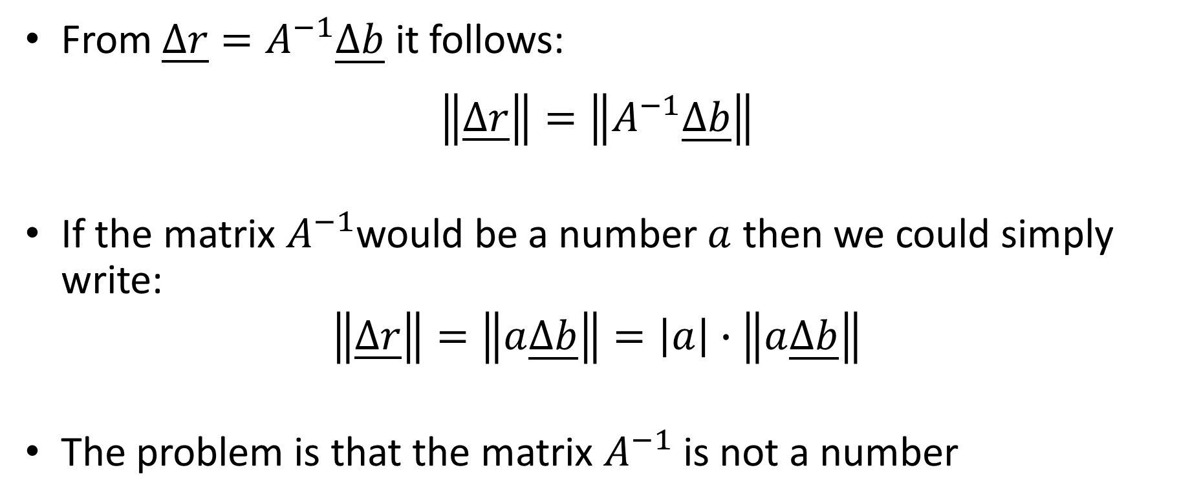
Quantifying the error $\left\|\underline{∆r}\right\|$
From $\underline{∆r}=A^{−1}\underline{∆b}$ it follows:
$$\left\|\underline{∆r}\right\|=\left\|A^{−1}\underline{∆b}\right\|$$
If the matrix $A^{−1}$would be a number $a$ then we could simply write:
$$\left\|\underline{∆r}\right\|=\left\|a\underline{∆b}\right\|=\left|a\right|∙\left\|a\underline{∆b}\right\|$$
The problem is that the matrix $A^{−1}$ is not a number
Notes:
If we want to quantify this error, we have to evaluate the norm of it.
We want to compute $\left\|\underline{∆r}\right\|=\left\|A^{−1}\underline{∆b}\right\|$
If the matrix $A^{−1}$would be a number $a$ then we could simply write:$\left\|\underline{∆r}\right\|=\left\|a\underline{∆b}\right\|=\left|a\right|∙\left\|a\underline{∆b}\right\|$
The problem is that the matrix $A^{−1}$ is not a number

Slide 7






How to quantify $\left\|A\underline{x}\right\|$?
In the case of a 2x2 matrix:
$$A\underline{x}=\left[\begin{matrix}a_{11} & a_{12} \\ a_{21} & a_{22}\end{matrix}\right]\left[\begin{matrix}x_{1} \\ x_{2}\end{matrix}\right]$$
$$x_{2}$$
$$A\underline{x}$$
$$\underline{x}$$
$$x_{1}$$
Notes:
In fact multiplying a vector by a matrix is very different than multiplying a vector by a number.
When you multiply a vector by a number you simple scale it. For example doubling it.
But when you multiply by a matrix you make a more complex operation.
As an example consider a 2x2 matrix.
If you start with a vector x, you will end up with a new vector Ax.
This new vector can be any where in the plane.
If we want to compare the norm of Ax with the norm of x, it will require some more mathematics.
At first we will restrict our considerations not to general vectors x, but to unity vectors. That are vectors with a norm of one.

Slide 8
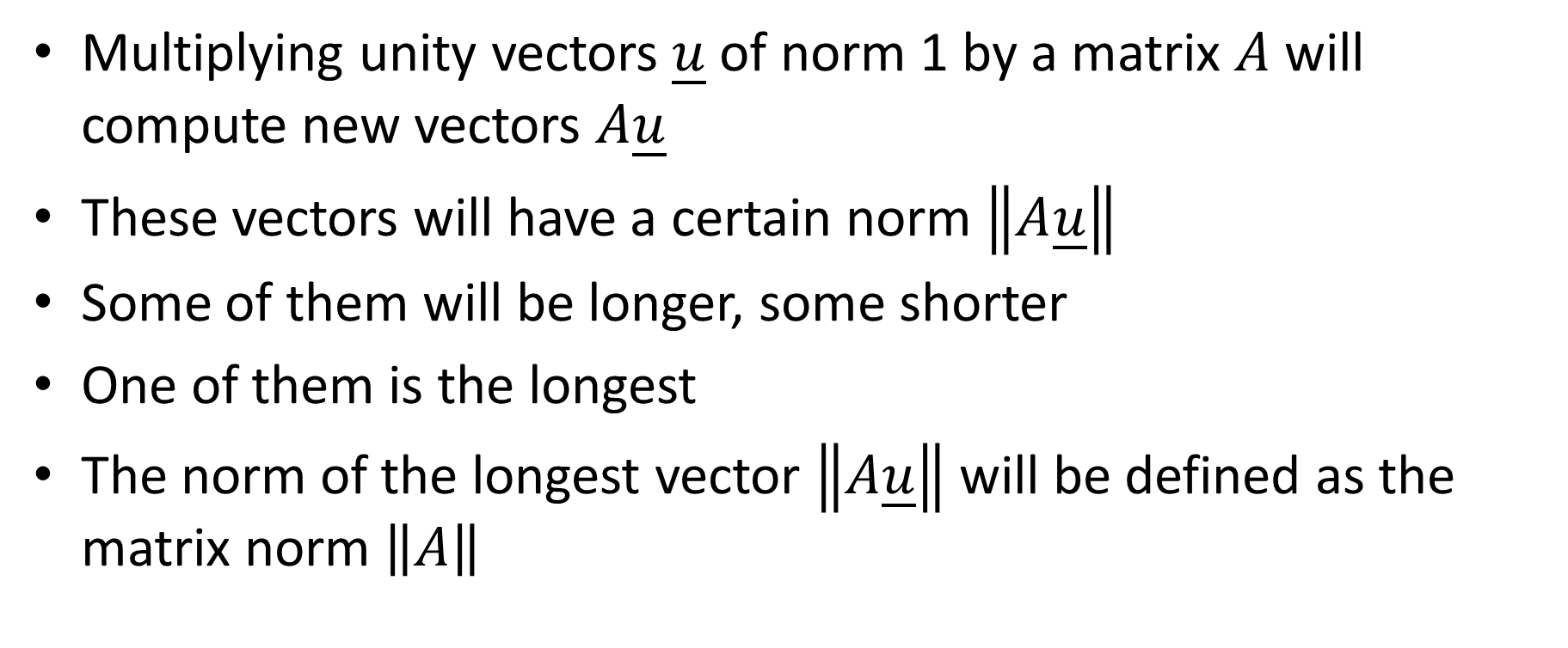
Multiplying unity vectors $\underline{u}$ of norm 1 by a matrix $A$ will compute new vectors $A\underline{u}$
These vectors will have a certain norm $\left\|A\underline{u}\right\|$
Some of them will be longer, some shorter
One of them is the longest
The norm of the longest vector $\left\|A\underline{u}\right\|$ will be defined as the matrix norm $\left\|A\right\|$
Notes:
As for a general vector x, multiplying unity vectors $\underline{u}$ of norm 1 by a matrix $A$ will compute new vectors $A\underline{u}$
These vectors will have a certain norm $\left\|A\underline{u}\right\|$
If the vector u is of norm one, the vector Au does not have to be of norm one.
Some of them will be longer, some shorter
But for sure one of them is the longest
The norm of the longest vector $\left\|A\underline{u}\right\|$ will be defined as the matrix norm $\left\|A\right\|$

Slide 9

Matrix Norm
Definition
The norm of a matrix $A$ is defined as the maximum of $\left\|A\underline{u}\right\|$ over all unity vectors $\underline{u}$ :
$$\max_{\left\|\underline{u}\right\|=1}\left\|A\underline{u}\right\|$$
Notes:
Formally:
The norm of a matrix $A$ is defined as the maximum of the norm of $Au$ over all unity vectors $\underline{u}$

Slide 10
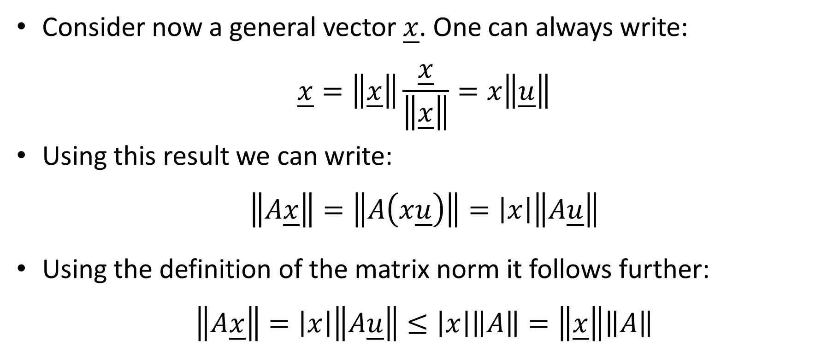
Consider now a general vector $\underline{x}$. One can always write:
$$\underline{x}=\left\|\underline{x}\right\|\frac{\underline{x}}{\left\|\underline{x}\right\|}=x\left\|\underline{u}\right\|$$
Using this result we can write:
$$\left\|A\underline{x}\right\|=\left\|A\left(x\underline{u}\right)\right\|=\left|x\right|\left\|A\underline{u}\right\|$$
Using the definition of the matrix norm it follows further:
$$\left\|A\underline{x}\right\|=\left|x\right|\left\|A\underline{u}\right\|≤\left|x\right|\left\|A\right\|=\left\|\underline{x}\right\|\left\|A\right\|$$
Notes:
Let us go back to our initial problem and consider a general vector x.
Of course we can always write
$$\underline{x}=\left\|\underline{x}\right\|\frac{\underline{x}}{\left\|\underline{x}\right\|}=x\left\|\underline{u}\right\|$$
where we write x for the norm of the vector x.
Let us now compute the norm of Ax.
We can write $\left\|A\underline{x}\right\|=\left\|A\left(x\underline{u}\right)\right\|=\left|x\right|\left\|A\underline{u}\right\|$
If we now use the definition of the matrix norm we can further write:
$$\left|x\right|\left\|A\underline{u}\right\|≤\left|x\right|\left\|A\right\|$$
This because the matrix norm of A is the longest vector Au.
Consequently the matrix norm of A is always larger or equal than the norm of Au

Slide 11

We just proved the important result:
Theorem
For any vector $\underline{x}$ on has:
$$\left\|A\underline{x}\right\|≤\left\|\underline{x}\right\|\left\|A\right\|$$
Notes:
We just proved an important result
For any vector $\underline{x}$ on has:$\left\|A\underline{x}\right\|≤\left\|\underline{x}\right\|\left\|A\right\|$

Slide 12
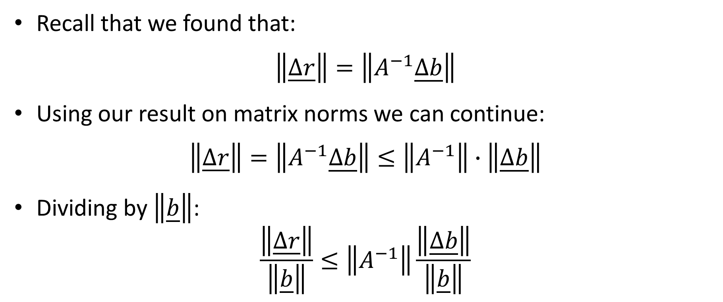
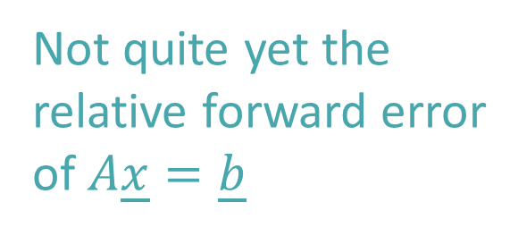
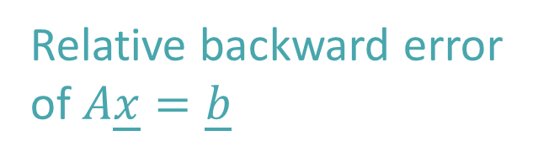
Recall that we found that:
$$\left\|\underline{∆r}\right\|=\left\|A^{−1}\underline{∆b}\right\|$$
Using our result on matrix norms we can continue:
$$\left\|\underline{∆r}\right\|=\left\|A^{−1}\underline{∆b}\right\|≤\left\|A^{−1}\right\|∙\left\|\underline{∆b}\right\|$$
Dividing by $\left\|\underline{b}\right\|$:
$$\frac{\left\|\underline{∆r}\right\|}{\left\|\underline{b}\right\|}≤\left\|A^{−1}\right\|\frac{\left\|\underline{∆b}\right\|}{\left\|\underline{b}\right\|}$$
Not quite yet the
relative forward error
of $A\underline{x}=\underline{b}$
Relative backward error
of $A\underline{x}=\underline{b}$
Notes:
With this result we can now evaluate the norm of $∆r$
As $∆r=A^{−1}\underline{∆b}$ we have:$\left\|\underline{∆r}\right\|=\left\|A^{−1}\underline{∆b}\right\|≤\left\|A^{−1}\right\|∙\left\|\underline{∆b}\right\|$
Dividing by $\left\|\underline{b}\right\|$ leads us to $\frac{\left\|\underline{∆r}\right\|}{\left\|\underline{b}\right\|}≤\left\|A^{−1}\right\|\frac{\left\|\underline{∆b}\right\|}{\left\|\underline{b}\right\|}$
That is already an interesting result.
On the right of the in-equation we have the relative error of $∆b$, which is as we know the relative backward error of our system Ax=b
On the left side of the equation we have something that start to look like the relative error of $∆r$, which is the relative forward error.
To find the relative error of $∆r$ we need somehow to replace $\left\|\underline{b}\right\|$ in the numerator by $\left\|\underline{r}\right\|$

Slide 13
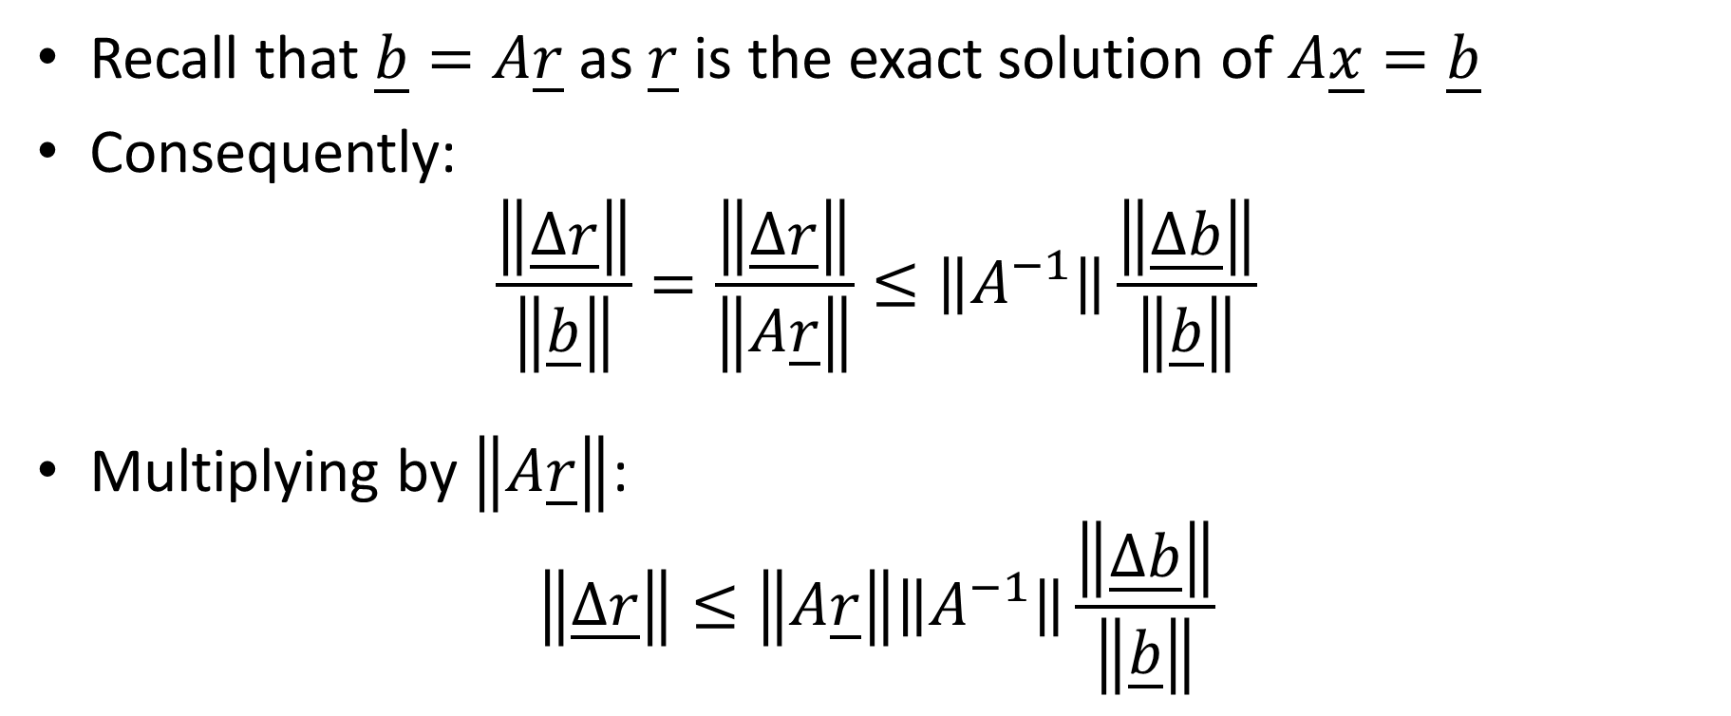
Recall that $\underline{b}=A\underline{r}$ as $\underline{r}$ is the exact solution of $A\underline{x}=\underline{b}$
Consequently:
$$\frac{\left\|\underline{∆r}\right\|}{\left\|\underline{b}\right\|}=\frac{\left\|\underline{∆r}\right\|}{\left\|A\underline{r}\right\|}≤\left\|A^{−1}\right\|\frac{\left\|\underline{∆b}\right\|}{\left\|\underline{b}\right\|}$$
Multiplying by $\left\|A\underline{r}\right\|$:
$$\left\|\underline{∆r}\right\|≤\left\|A\underline{r}\right\|\left\|A^{−1}\right\|\frac{\left\|\underline{∆b}\right\|}{\left\|\underline{b}\right\|}$$
Notes:
Recall that $\underline{b}=A\underline{r}$ as $\underline{r}$ is the exact solution of $A\underline{x}=\underline{b}$
Consequently we can write:$\frac{\left\|\underline{∆r}\right\|}{\left\|\underline{b}\right\|}=\frac{\left\|\underline{∆r}\right\|}{\left\|A\underline{r}\right\|}$
Multiplying by $\left\|A\underline{r}\right\|$ leads us to $\left\|\underline{∆r}\right\|≤\left\|A\underline{r}\right\|\left\|A^{−1}\right\|\frac{\left\|\underline{∆b}\right\|}{\left\|\underline{b}\right\|}$

Slide 14
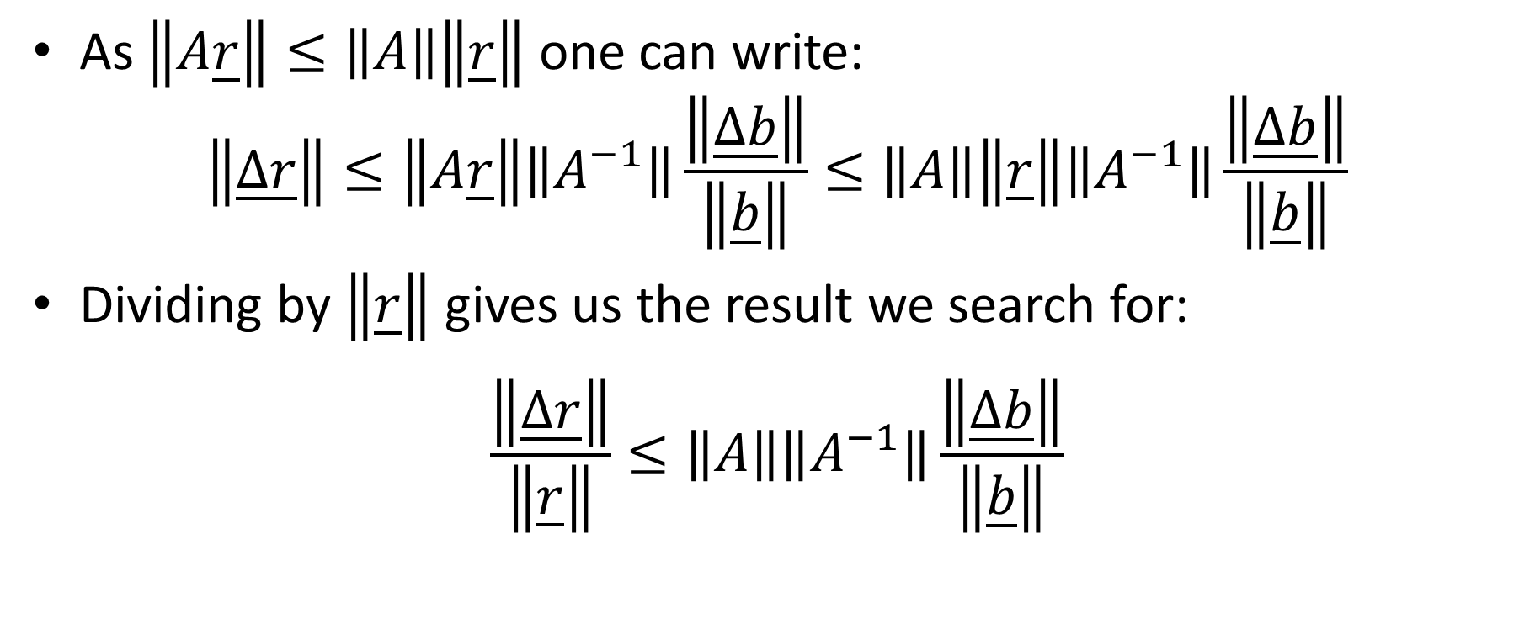


As $\left\|A\underline{r}\right\|≤\left\|A\right\|\left\|\underline{r}\right\|$ one can write:
$$\left\|\underline{∆r}\right\|≤\left\|A\underline{r}\right\|\left\|A^{−1}\right\|\frac{\left\|\underline{∆b}\right\|}{\left\|\underline{b}\right\|}≤\left\|A\right\|\left\|\underline{r}\right\|\left\|A^{−1}\right\|\frac{\left\|\underline{∆b}\right\|}{\left\|\underline{b}\right\|}$$
Dividing by $\left\|\underline{r}\right\|$ gives us the result we search for:
$$\frac{\left\|\underline{∆r}\right\|}{\left\|\underline{r}\right\|}≤\left\|A\right\|\left\|A^{−1}\right\|\frac{\left\|\underline{∆b}\right\|}{\left\|\underline{b}\right\|}$$
Relative forward error
of $A\underline{x}=\underline{b}$
Relative backward error
of $A\underline{x}=\underline{b}$
Notes:
Using again our result on matrix norms allows us to continue and find that
$$\left\|\underline{∆r}\right\|≤\left\|A\right\|\left\|\underline{r}\right\|\left\|A^{−1}\right\|\frac{\left\|\underline{∆b}\right\|}{\left\|\underline{b}\right\|}$$
This because $\left\|A\underline{r}\right\|≤\left\|A\right\|\left\|\underline{r}\right\|$
Dividing by $\left\|\underline{r}\right\|$ gives us the result we look for
We have now on the left side of the equation the relative error of Delta r, that is the relative forward error of our system Ax=b
And on the right side the relative error of Delta ab, that is the relative backward error of our system Ax=b

Slide 15
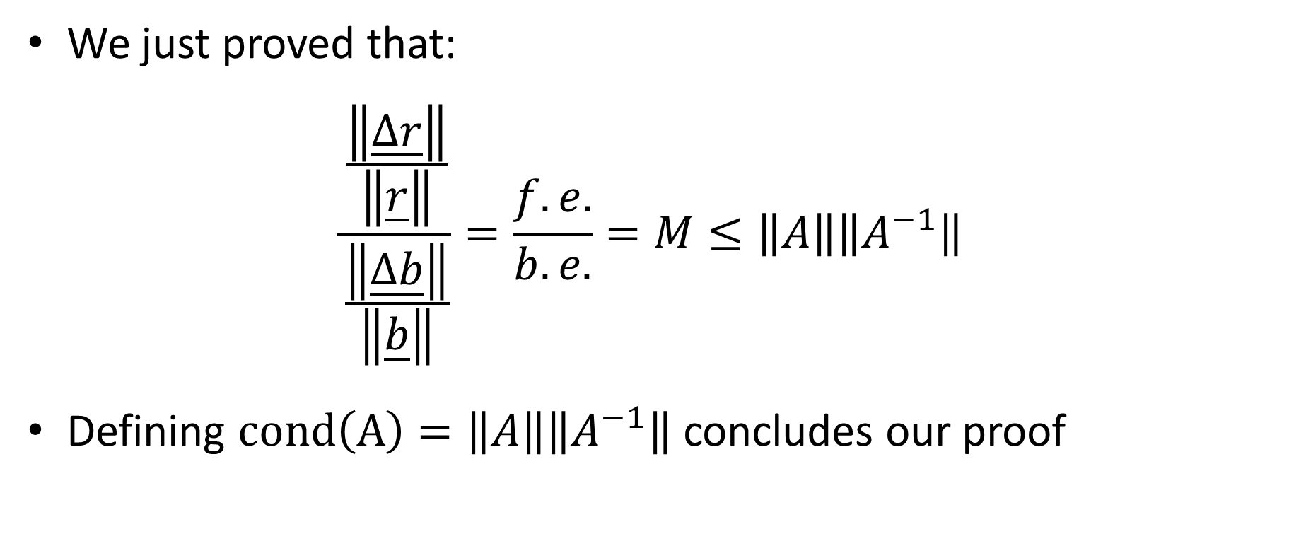
We just proved that:
$$\frac{\frac{\left\|\underline{∆r}\right\|}{\left\|\underline{r}\right\|}}{\frac{\left\|\underline{∆b}\right\|}{\left\|\underline{b}\right\|}}=\frac{f.e.}{b.e.}=M≤\left\|A\right\|\left\|A^{−1}\right\|$$
Defining $cond\left(A\right)=\left\|A\right\|\left\|A^{−1}\right\|$ concludes our proof
Notes:
Rearranging leads us to the statement that the error magnification fact M is always smaller or equal to the product of the matrix norm of A and the matrix norm of the inverse of A.
Defining the conditioning number of a matrix A as the product of the matrix norm of A and the matrix norm of the inverse of A concludes our proof

Slide 16
How to compute the matrix norm?
In this second part of the lecture we will show how from the definition of the matrix norm follows the way we have learned to calculate it
We will show this for the particular case of 2x2 matrices and for the infinity norm
Notes:
In this second part of the lecture we will show how from the definition of the matrix norm follows the way we have learned to calculate it
We will show this for the particular case of 2x2 matrices and for the infinity norm

Slide 17
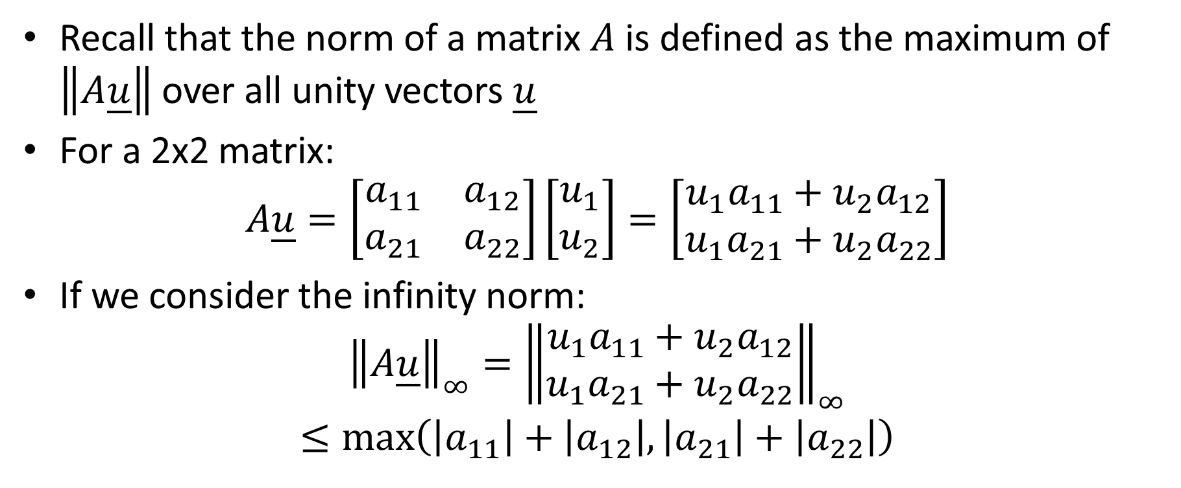


Recall that the norm of a matrix $A$ is defined as the maximum of $\left\|A\underline{u}\right\|$ over all unity vectors $\underline{u}$
For a 2x2 matrix:
$$A\underline{u}=\left[\begin{matrix}a_{11} & a_{12} \\ a_{21} & a_{22}\end{matrix}\right]\left[\begin{matrix}u_{1} \\ u_{2}\end{matrix}\right]=\left[\begin{matrix}{u_{1}a}_{11}+u_{2}a_{12} \\ {u_{1}a}_{21}+{u_{2}a}_{22}\end{matrix}\right]$$
If we consider the infinity norm:
$${\left\|A\underline{u}\right\|}_{∞}={\left\|\begin{matrix}{u_{1}a}_{11}+u_{2}a_{12} \\ {u_{1}a}_{21}+{u_{2}a}_{22}\end{matrix}\right\|}_{∞}$$
$$≤\max_{}\left(\left|a_{11}\right|+\left|a_{12}\right|,\left|a_{21}\right|+\left|a_{22}\right|\right)$$
at maximum $\left|a_{11}\right|+\left|a_{12}\right|$
at maximum $\left|a_{21}\right|+\left|a_{22}\right|$
Notes:
Recall that the norm of a matrix $A$ is defined as the maximum of the norm of $Au$ over all unity vectors $\underline{u}$
Let us study this a little more in details for the case of a 2x2 matrix
First compute the product between a general matrix A and a general unity vector u.
Let us try to understand how much would be the infinity norm of Au
Recall that the infinity norm of a vector is the largest entry in the vector in absolute value.
Let us consider the first entry of the vector Au.
This is equal to ${u_{1}a}_{11}+u_{2}a_{12}.$
Recall that u is a unity vector. That means, because we use the infinity norm, that either u1 or u2 must be equal to one.
Both could be equal one too. But none can be larger than one.
Having this observation in mind, what will be the maximal value of this first entry of the vector Au?
It is at maximum the sum of the absolute values of a11 and a12.
In the same way the maximal value the second entry of the vector Au can have is the sum of the absolute values of a21 and a22.
Consequently the largest possible value the infinity norm of the vector Au can take is the maximum between
the sum of the absolute values of a11 and a12 and
the sum of the absolute values of a21 and a22.
That is the largest absolute row sum of the matrix A.
This is exactly how we have learned to compute the infinity norm of a matrix.
The result could be generalized to a n by n matrix.

Slide 18

Summary
We proved that the conditioning number of a matrix $A$ is the maximal error magnification factor one can expect when solving the system $A\underline{x}=\underline{b}$
We showed how the matrix norm has to be computed
Notes:
Let us summarize the key findings
We proved that the conditioning number of a matrix $A$ is the maximal error magnification factor one can expect when solving the system $A\underline{x}=\underline{b}$
We showed how the matrix norm has to be computed

